Slide 1



Slide 2

Share Parking Space
Supervised by:
Sir Muhammad Jamal Ahmed
Group Members:
[Muqaddas hameed] (CIIT/FA17-BCS-053/ATK)
[Sana Ishfaq] (CIIT/FA17-BCS-077/ATK)
Presented on [06/12/2020]
Department of Computer Science
COMSATS University Islamabad, Attock Campus

Slide 3
Outline:
Introduction
Working flow
Comparison table
Problem statement
Objectives
Interface
Methodology
Modern tools
Benefits
References

Slide 4

Introduction:
With the rapid increase in vehicle usages , finding and accessing free parking space has become time consuming and tedious, especially in big cities.
Application recommend the nearest parking spaces to the user on his/her map of specified city with different prices and rating so that user can book parking space of his/her own choice.
This project provides an additional feature of canceling the bookings. This application facilitates parking reservation in both commercial and non-commercial (homes) areas.
There is also a feature that if someone parks his/her vehicle for a certain time then another person can use their vehicle for that time and the buyer will pay the amount according to the certain time. So, both sides will get benefit from this application.
Another feature is the recommendation system in which the nearest or recently visited places are recommended to the user.

Slide 5
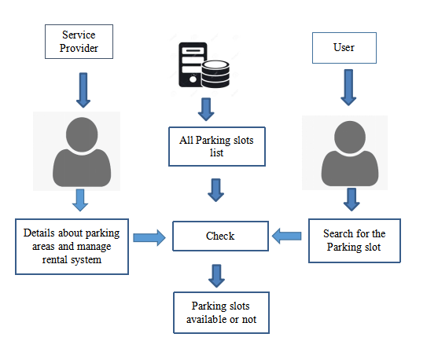
Working flow:

Slide 6
Applications And Comparison Table:
Functionality | GPS based | Provide places on non-Commercial areas | Recommendation system | Renting
Smart Parking | ✔ | ✖ | ✖ | ✖
Parkopedia Parking: | ✔ | ✖ | ✖ | ✖
SMS Parking: | ✔ | ✖ | ✖ | ✖

Slide 7
Problem statement:
As the population increases, the demand for the vehicles also increases. Now a days very few people rely on public transport. Due to increase in vehicles traffic jam is one of the common problem in the developing countries. One of the prime reason of traffic jam is parking vehicles on the road side so we need to evolve to develop a parking system. If anyone wants to park his/her vehicle, most of the time wasted in search of parking spaces. Especially, reserved parking area in commercial areas are full in busy hours. This leads to the stress, anxiety and a wastage of time
Q1: How to know about different parking places of your area?
Q2: How to help Users to Book parking places online and at reasonable prices?

Slide 8
Objectives:
To learn about parking areas for particular locations.
To create a cost-effective parking system.
To make parking safer, secure and authentic.
To reduce human effort.
Remote access to the information of availability of parking space.
Automatic billing.
To save user’s time.

Slide 9
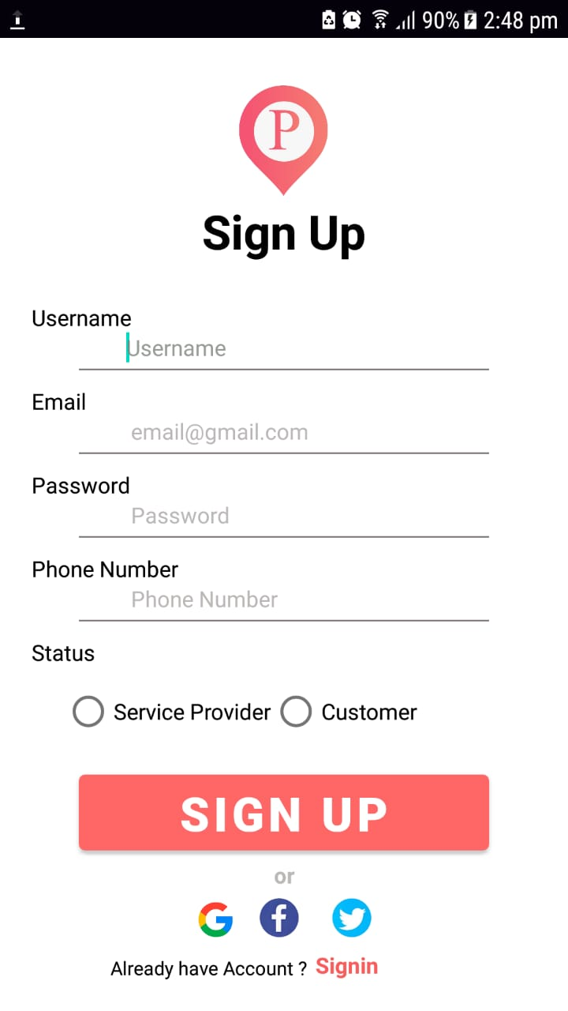
Interface Sign up Activity:
User and service provider make thier account by sign up.if not they don't have any access to post places or booking places.

Slide 10
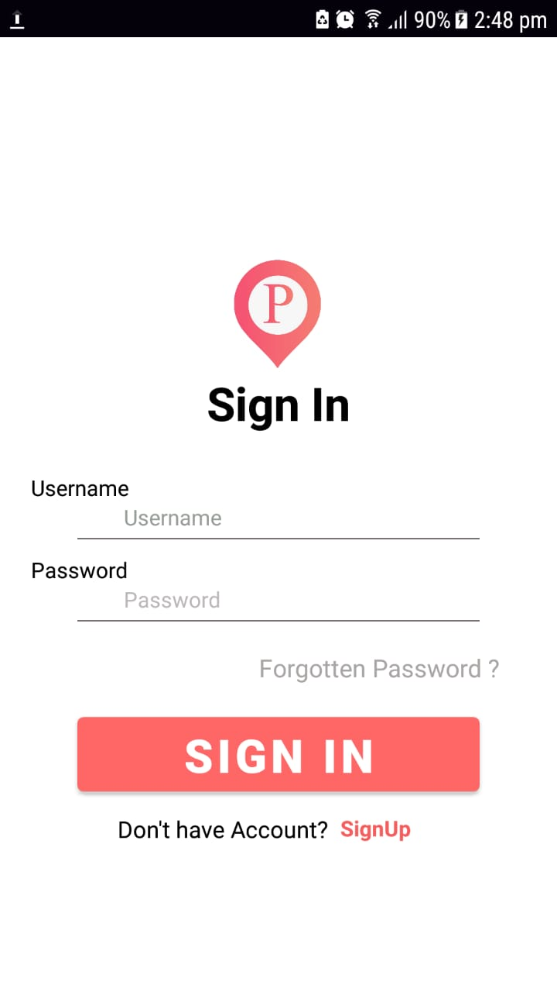
Login Activity:
User can be login through this activity to perform further necessary action in order to startbooking or post places process and this activity is for developed account, users need to be sign up before logging in

Slide 11
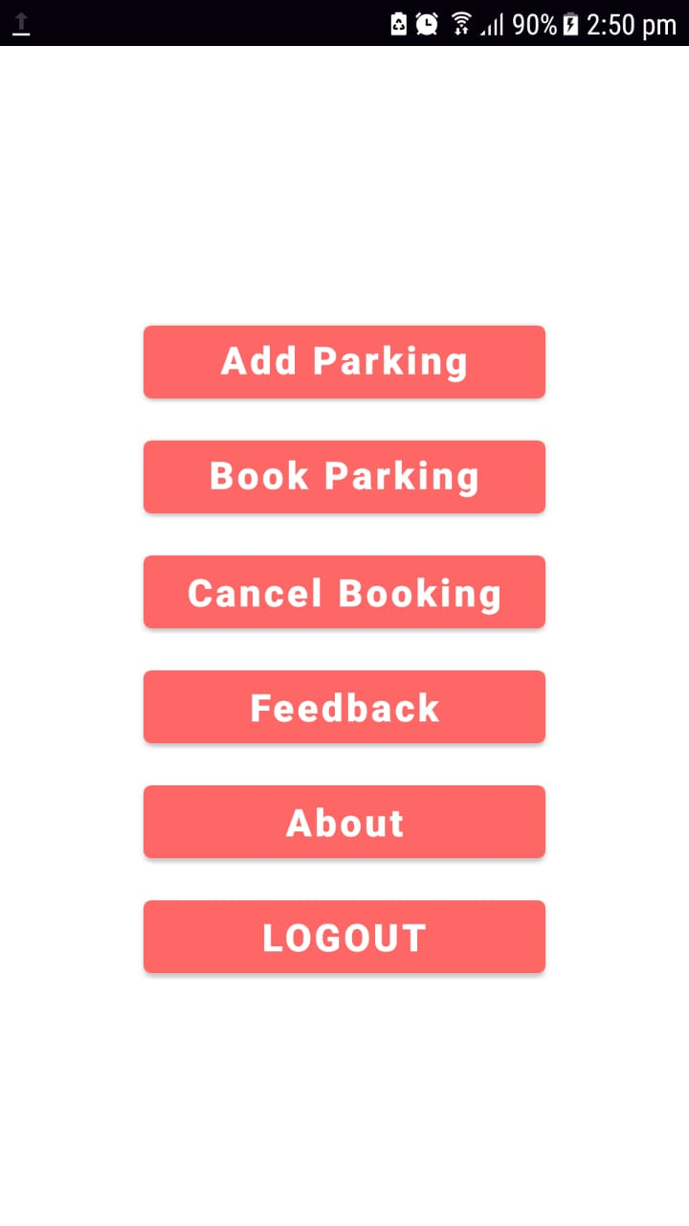
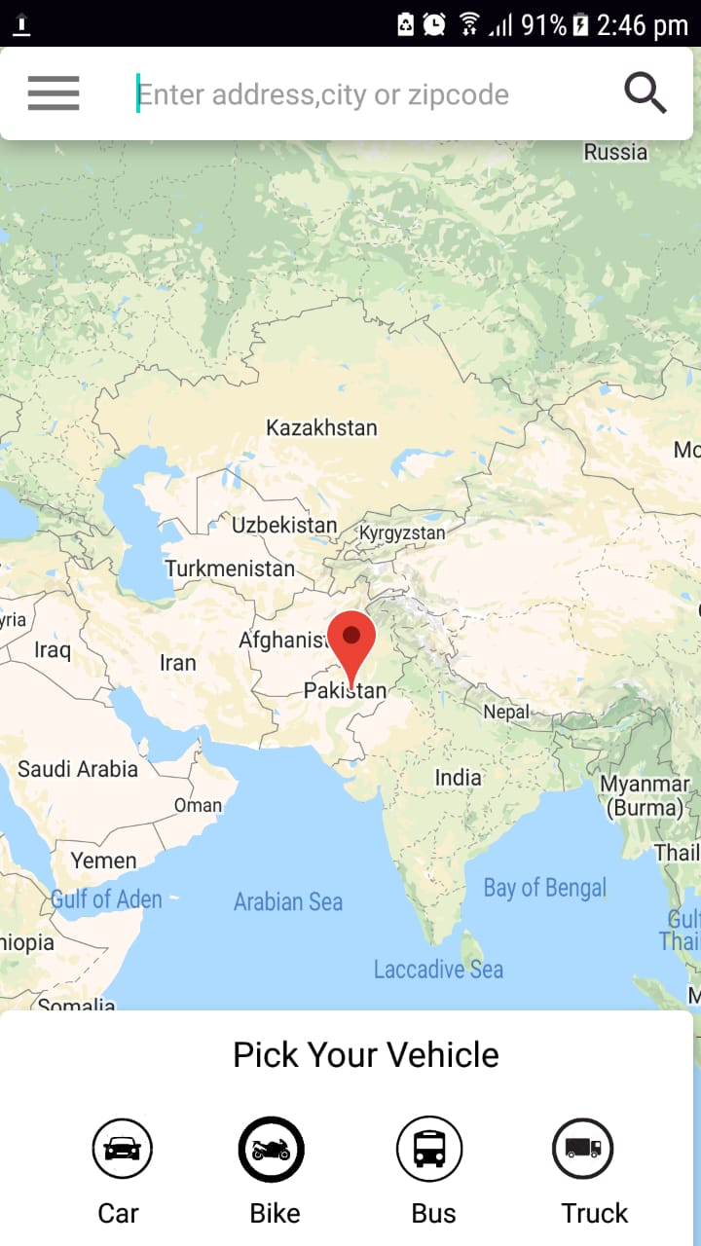
Dashboard
This homepage is for user after successfully login and to perform further activities .
User's Searching Location
After logging in, Users can view via profile activity that can be accessed through dashboard of application and can logout from main menu.

Slide 12
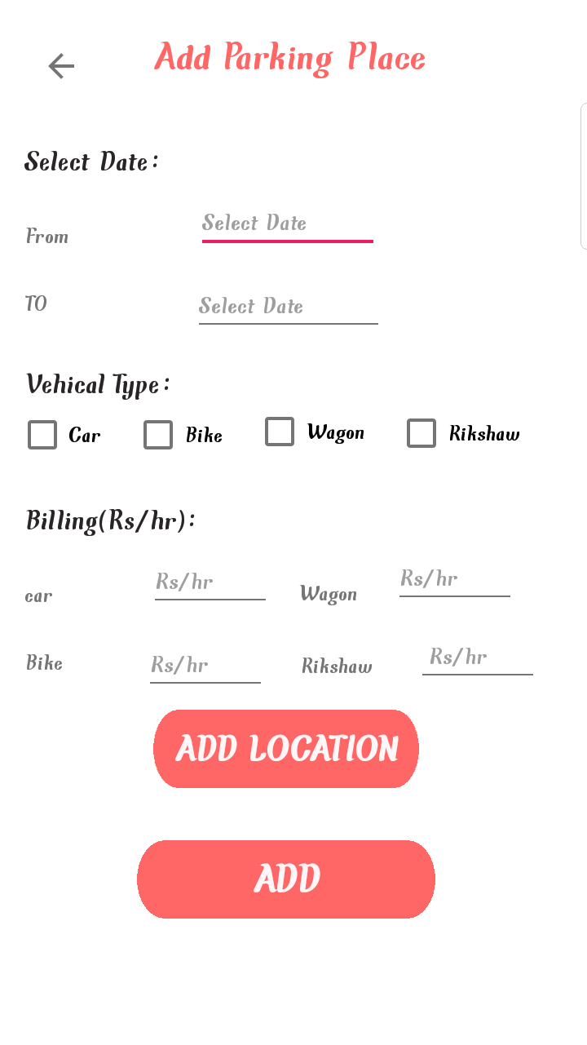
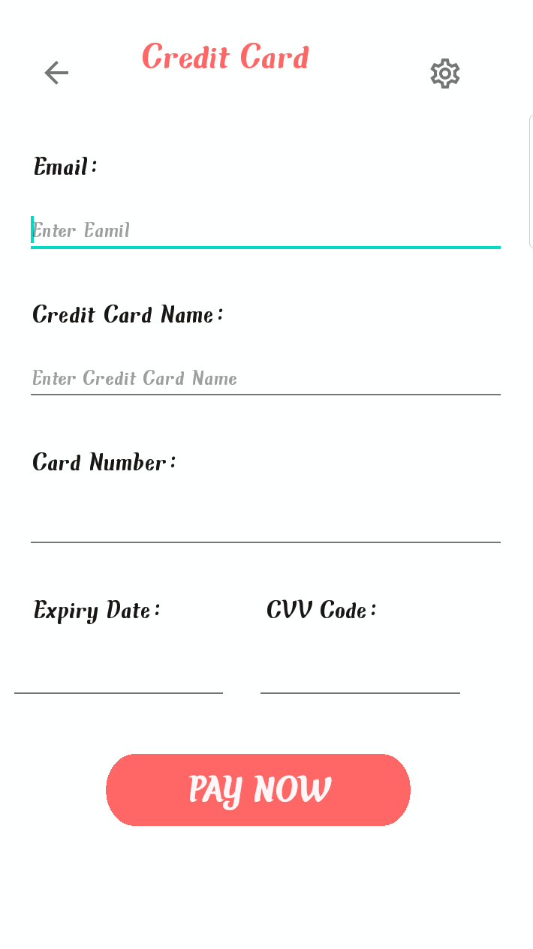
Service Provider Dashboard
After Login Service provider have to add places for parking.
Credientials
User After booking places then pay bill either cash on parking or through credit card

Slide 13
Development Requirements
Software Requirements dependence:
Java Programming Language
Android Studio & SDK
Firebase
Star UML
Google Maps
Flask Framework
Python
Unsupervised Machine Learning Algorithm.

Slide 14
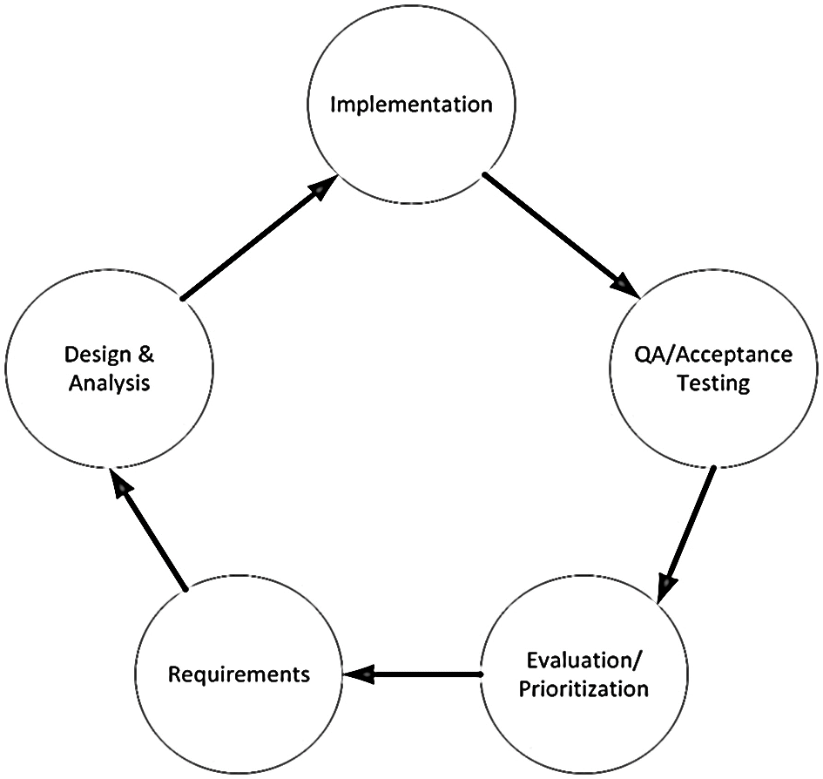
Rationale behind Selected Methodology
We have selected Iterative Approach for our project. As in iterative approach every module is explained in a detailed way and in repeated cycles. If requirements change during development then we can easily handle these changes in next iteration. It will also help us in future work to add more features in a project.

Slide 15
Modern tools:
Tools | Version | Rationale
Android studio &SDK | 4.0.1 | IDE
Firebase | 7.2.0 | DB
Star UML | 1.4 | Design Usecase
Python | 3.9.1 | Recommendation

Slide 16
Benefits
Learn about parking areas for particular locations.
Reduce human effort.
Provie remote access to the information of availability of parking space.
Automatic billing.
It saves user’s time.
This application facilitates parking reservation in both commercial and non-commercial (homes) areas.
Provide Rental system.

Slide 17
References
Fatima, Nazish et al. “IOT Based Smart Car Parking System for Smart Cities.” International Journal of Advance Research, Ideas and Innovations in Technology 4 (2018): 554-558[2]
Khanna, Abhirup & Anand, Rishi. (2016). IoT based Smart Parking System. 10.1109/IOTA.2016.7562735.

